Slide 1
Photo-Thermal Response of a Vesicle Nanoparticle
By Megan Pulford

Slide 2
Table of Contents
Background and Introduction
Nanoparticles
Importance
The Lycurgus Cup
Vesicle Nanoparticles
Materials
Dimension
Creation
Electromagnetism
Thermodynamics
Applications

Slide 3
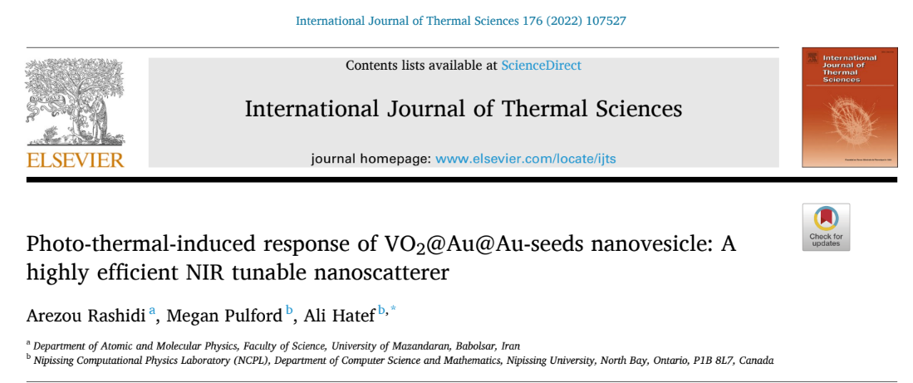
Background

Slide 4
Introduction

Slide 5
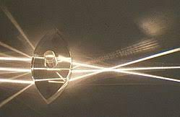
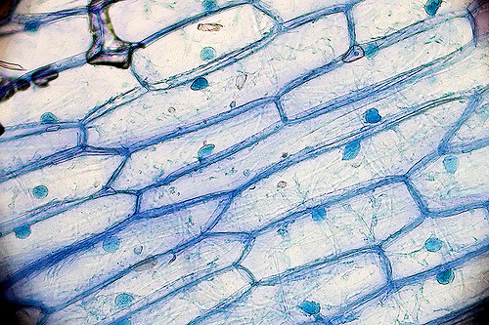
Conventional Way of Light Localization
Lens
Common way to enhance and focus light sources
Enhances images
Limit on size enhancement
Notes:
Convex lens and onion skin in microscope

Slide 6
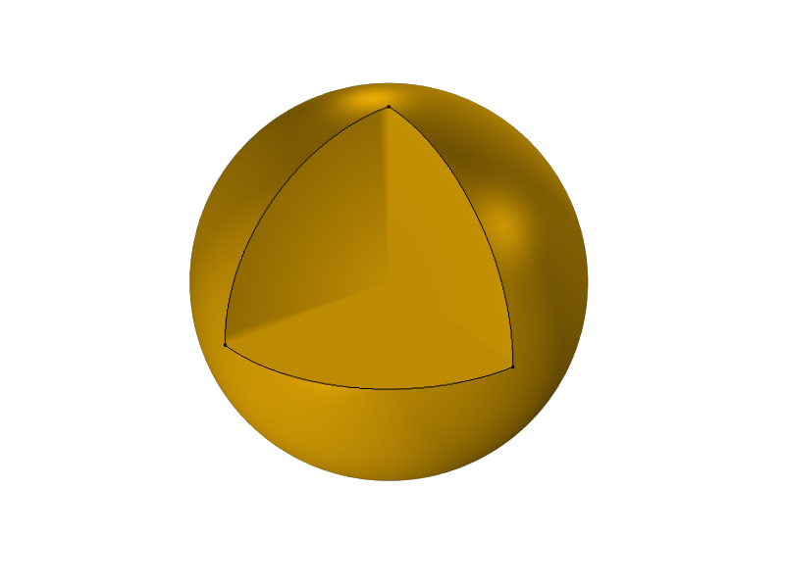
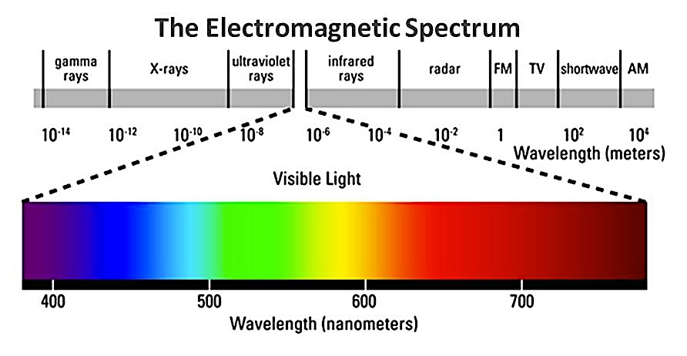
Nanosized Light Localizers
Nanoparticles
Smaller than the visible light range
Overcome the diffraction limit
The optical resolution that lens cannot achieve
100 nm

Slide 7
Gold Nanoparticles vs Bulk Gold

Slide 8
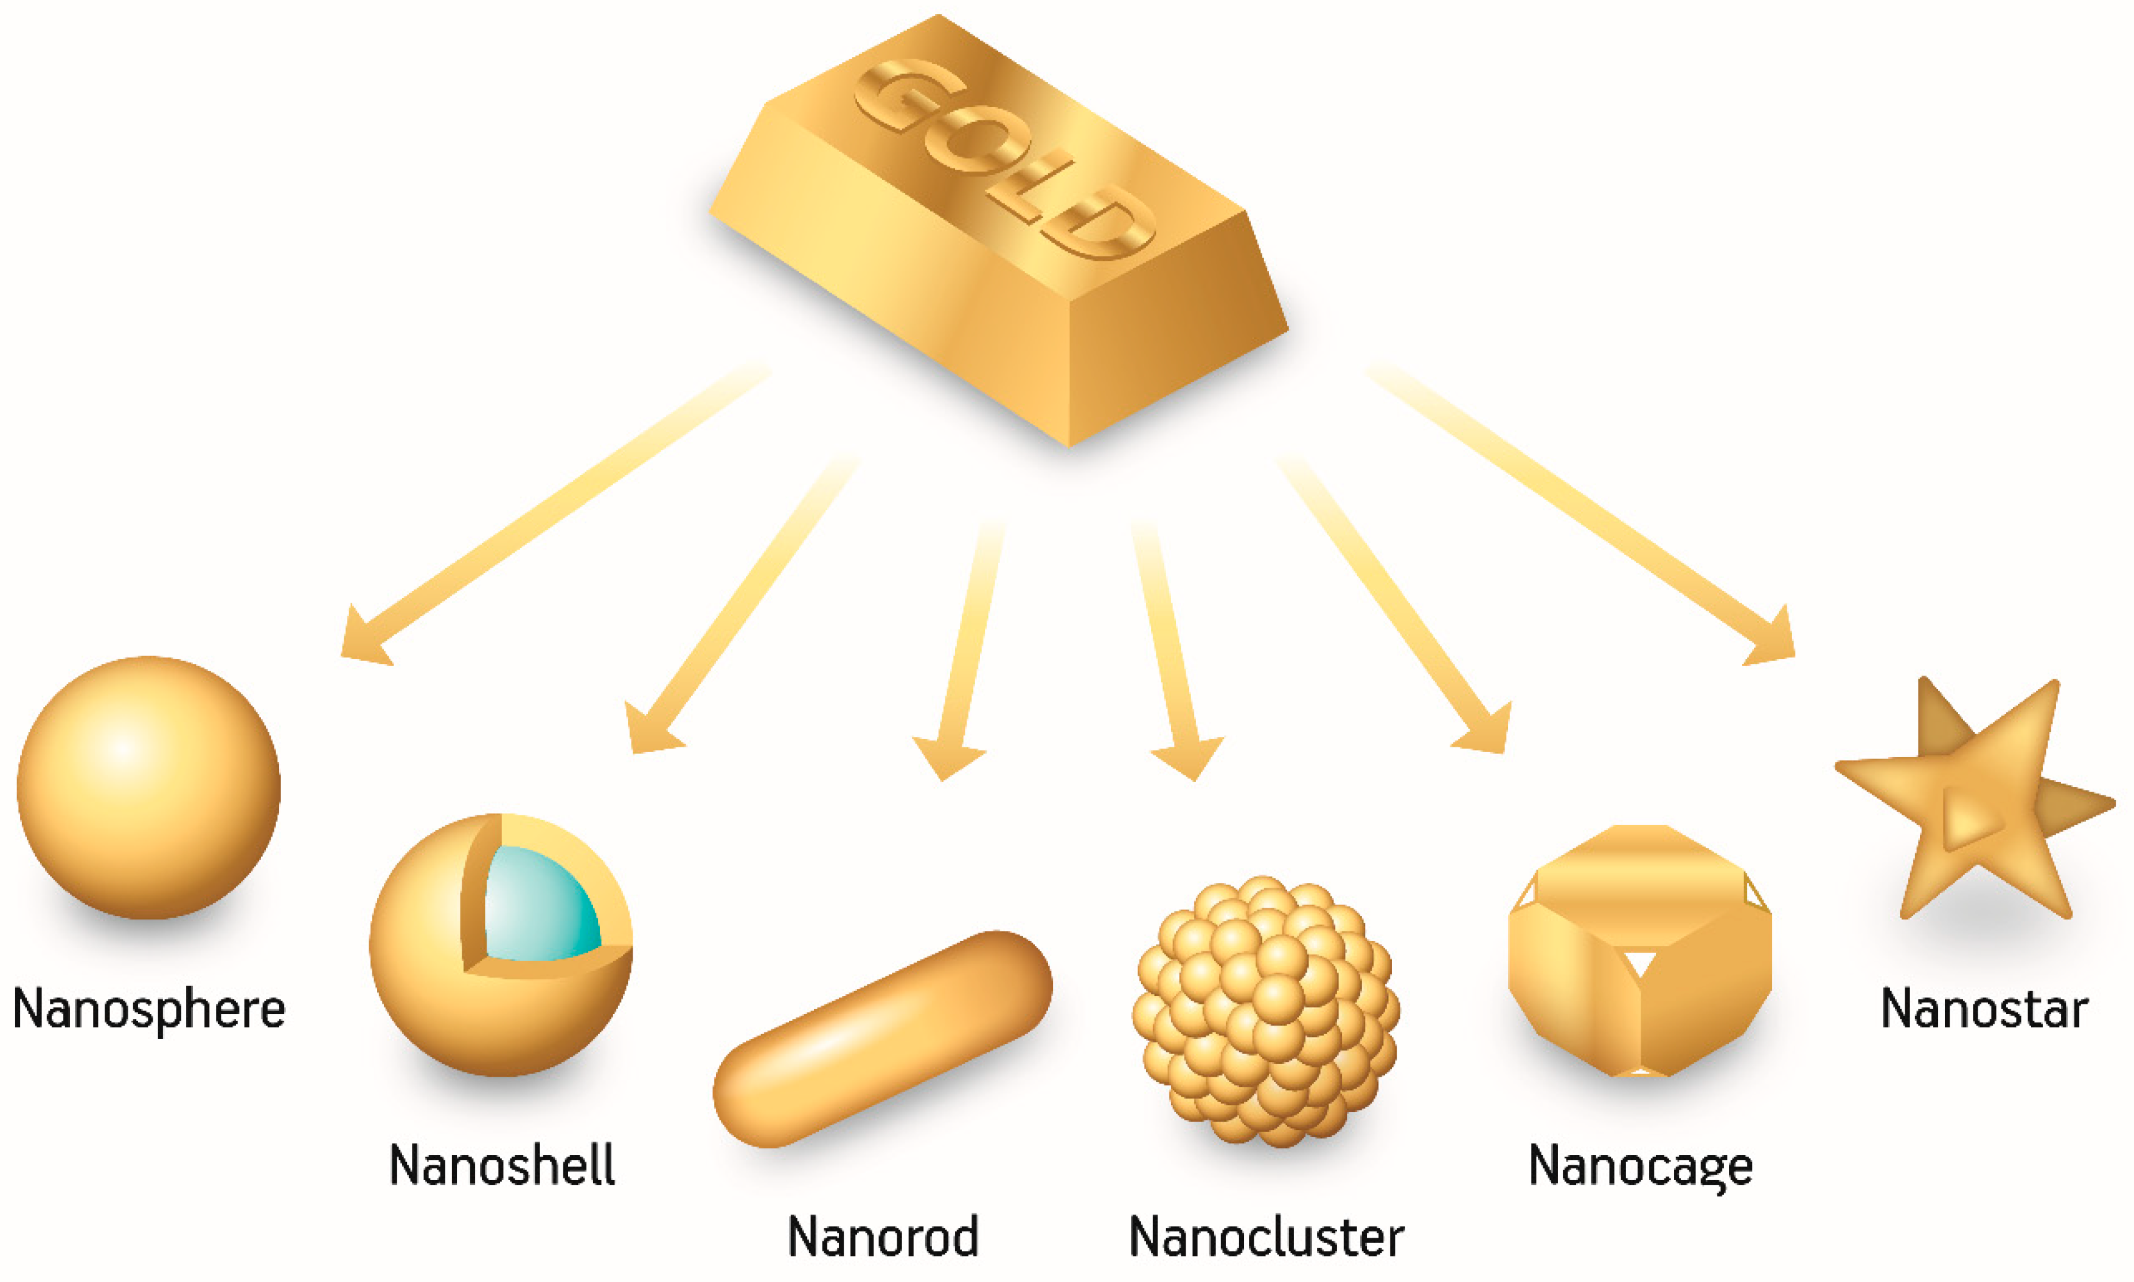
Applications of Nanoparticles
Uses in Multiple Fields
Medical, research, etc.
Real World Applications:
Medical Uses:
Hypothermia Therapy
Cancer Therapy
Sterilization and Disinfection
Nano Thermal Sensor

Slide 9
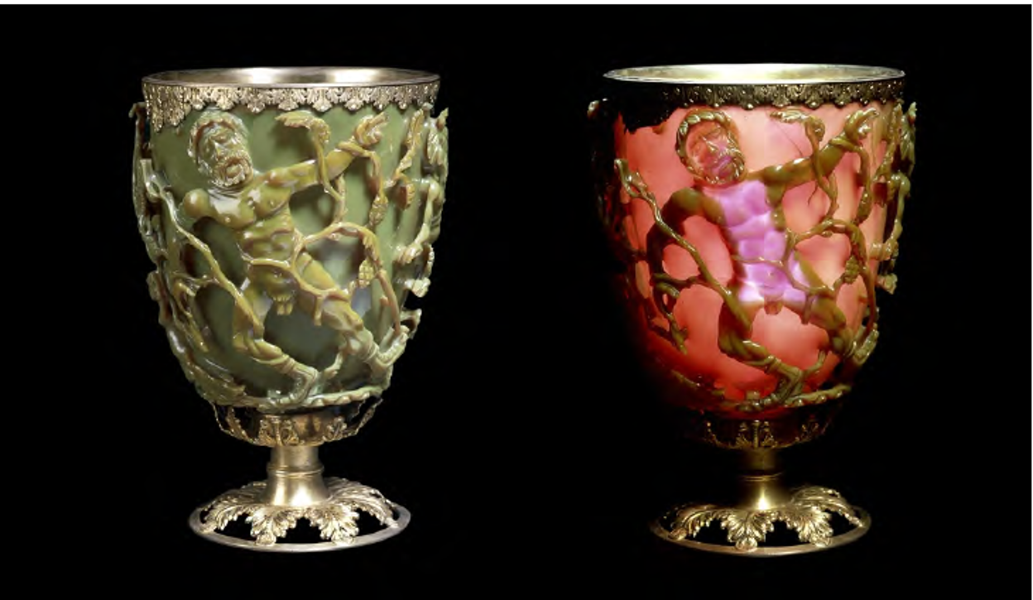
The Lycurgus Cup

Slide 10
The Lycurgus Cup
Glass contains gold nanoparticles
Behaves differently dependent on where light source is
Light source outside of cup will show green glass
Scatters green light
Light source inside of cup will shown red glass
Absorbs red light

Slide 11
Metallic Nanoparticles

Slide 12
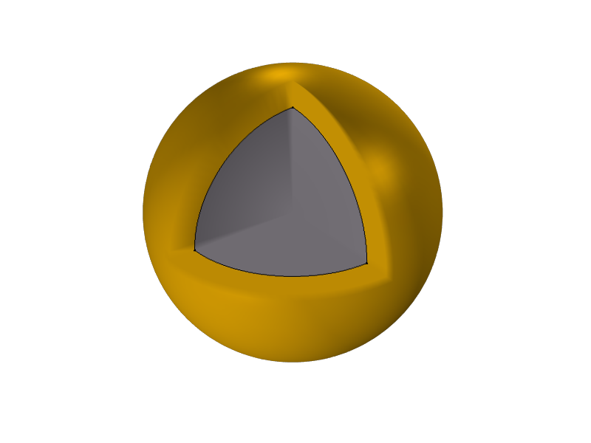
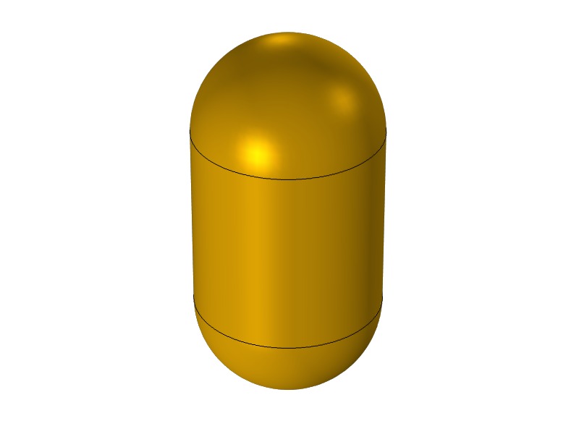
Background
On the nanoscale
To allow for a strong interaction with visible light range
Interaction with light depends on four main aspects:
Material of nanoparticle
Size
Shape
Material of surrounding medium

Slide 13
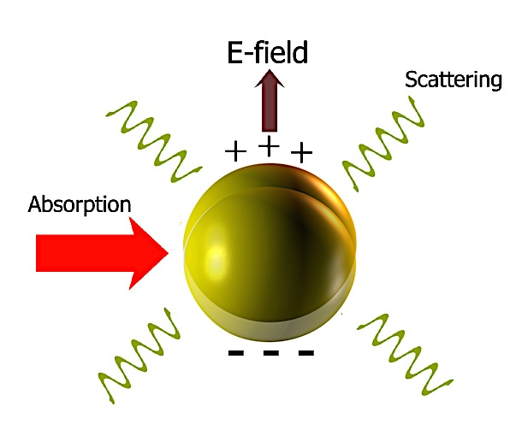
Interaction with Light
Optical properties can be determined:
Absorption Cross Section
Scattering Cross Section
Extinction Cross Section
Electric Field Enhancements
All cross sections depend on the polarization
The ability of a nanoparticle to create a dipole moment
$$α=3Vε_{s}\frac{ε −ε_{s}}{ε+2ε_{s}}$$

Slide 14
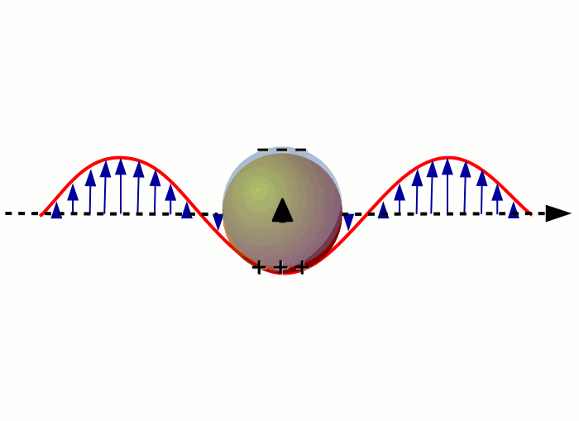
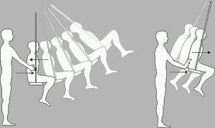
Nanoparticle Interaction with Light

Slide 15
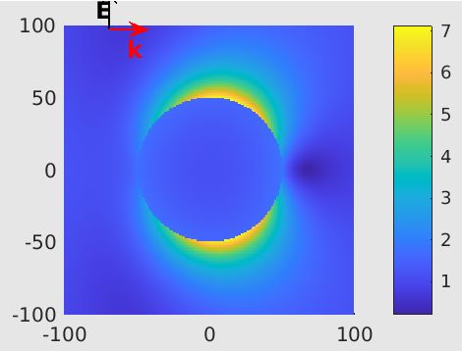
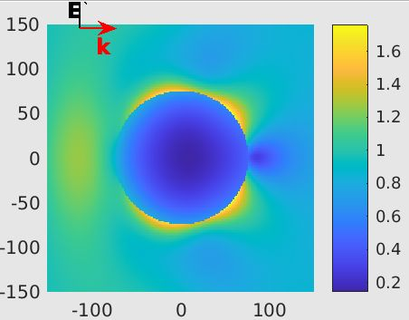
Electric Field Influence
Gold Nanoparticle, r = 50 nm, λ = 579 nm
Gold Nanoparticle, r = 75 nm, λ = 350 nm

Slide 16
Optical Cross Section for Simple Nanoparticle
Absorption Cross Section
Effective area that the particle can absorb light
$$C_{a}= \frac{k}{ε_{0}}∙α_{i}$$
𝐶_𝑎= 𝑘/𝜀_0 ∙𝛼_𝑖
Scattering Cross Section
Effective area that the particle can scatter light
$$C_{s}= \frac{k^{4}}{6πε_{0}^{2}}∙\left|α\right|$$
𝐶_𝑠= 𝑘^4/(6𝜋𝜀_0^2 )∙|𝛼|
Extinction Cross Section
Total loss of incident light
$$C_{e}= C_{a}+C_{s}$$
𝐶_𝑒= 𝐶_𝑎+𝐶_𝑠
Larger means strong absorber
Larger means strong scatterer
$$k= \frac{2πn_{m}}{λ_{0}}$$
Notes:
Reasons & examples

Slide 17
Comparing Nanoparticles
Au NP in water, r = 50 nm
Au NP in water, r = 20 nm
Notes:
Peaks are maximum interference with particle

Slide 18
Comparing Nanoparticles
Au NP in water, r = 50 nm
Au NP in air, r = 50 nm

Slide 19
Comparing Nanoparticles
Au NP in water, r = 50 nm
SiO₂ core, r = 20 nm, Au shell, 10 nm, in water

Slide 20
Vesicle Nanoparticle

Slide 21
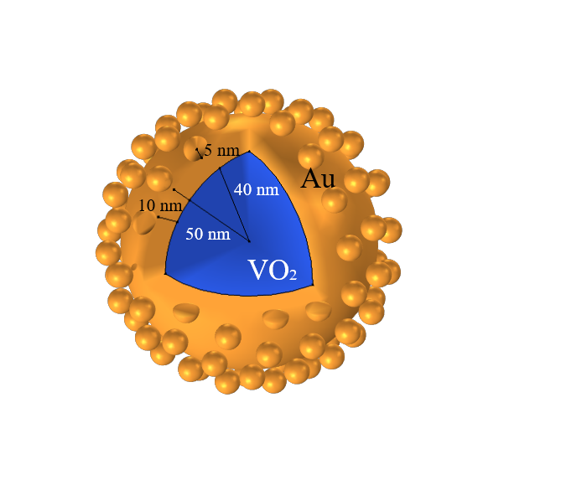
Vesicle Nanoparticle
Vanadium Dioxide (VO₂) core, Gold (Au) shell and Au nanoseeds
Notes:
DO NOT SAY CREATE
Called Vesicle because it looks like the lipids, or vesicles, on a cell
Has been fabricated experimentally

Slide 22
Materials and Dimensions
Materials
Dimensions
Gold (Au)
Helps the VO₂ core heat up and cause a phase change
Vanadium Dioxide (VO₂)
Can have semiconductor or conductor properties
Induces tunability to the overall structure
Core
VO₂ Core
40 nm radius
Au Shell
10 nm thick
Nanoseeds
Uniform size of 5 nm radius each
Number determined by the amount of volume to be filled by nanoseeds

Slide 23
Creating The Nanoseeds
Number of Nanoseeds, N
Need a fixed value based off how full layer of nanoseeds will be, f_{v} = 0.16
Number of Latitudinal Circles around Half of Sphere, m
Half the sphere used to later mirror
$$m= \sqrt{\frac{\frac{N}{2}∙π}{8}}$$
𝑚= √((𝑁/2∙𝜋)/8)
Number of Nanoseeds in Each Latitudinal Circle, k(q), $q ε [1, m]$
Number of Nanoseeds in Each Latitudinal Circle, k(q), 𝑞 𝜖 [1, 𝑚]
Each latitudinal circle will have a different radius, cannot all have the same number of particles
$$k\left(q\right)= \frac{N ∙ \sin\left[(q − \frac{1}{2})∙(\frac{π}{2m})\right]}{\csc\left(\frac{π}{4m}\right)}$$
𝑘(𝑞)= (𝑁 ∙ sin⁡[(𝑞 − 1/2)∙(𝜋/2𝑚)])/csc⁡(𝜋/4𝑚)
$$N=f_{v} \frac{{(S+2a)}^{3} −S^{3}}{a^{3}}$$
𝑁=𝑓_𝑣 (〖(𝑆+2𝑎)〗^3 −𝑆^3)/𝑎^3
Notes:
Created uniformly, lower fill fraction to prevent overlapping

Slide 24
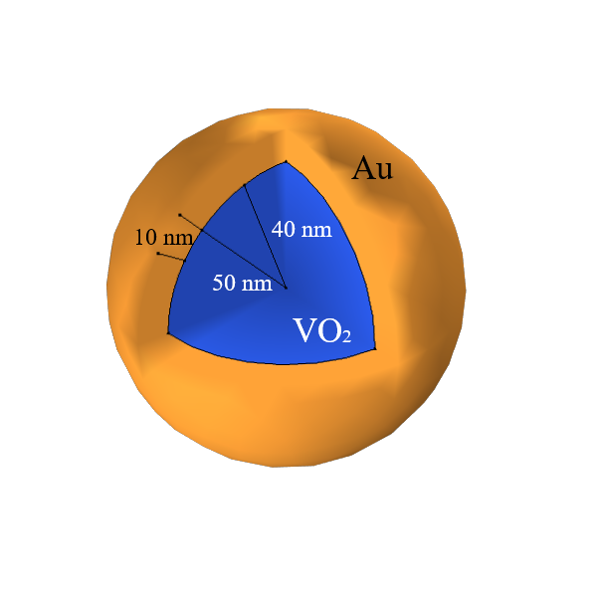
Placing The Nanoseeds

Slide 25
Optical Properties
Determines how the VNP will interact with the electric field
Permittivity, refractive index
Absorption, scattering, extinction, electric field enhancement
Au properties depend on wavelength
VO₂ properties depend on wavelength and temperature

Slide 26
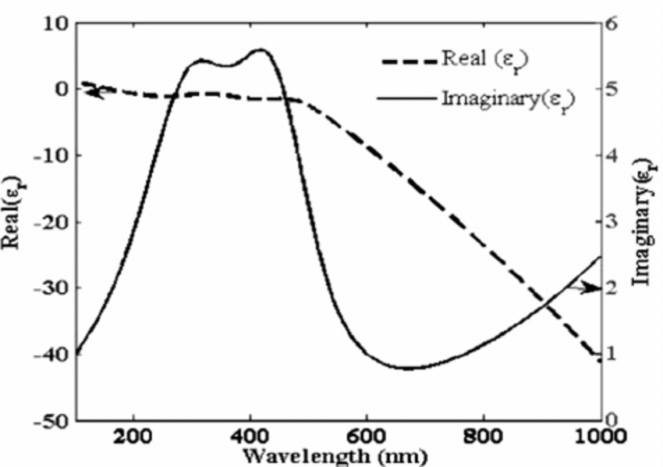
Permittivity of Gold ($ε= ε^{′}+i∙ε′′)$
Notes:
Real part is negative for metals (permittivity)

Slide 27
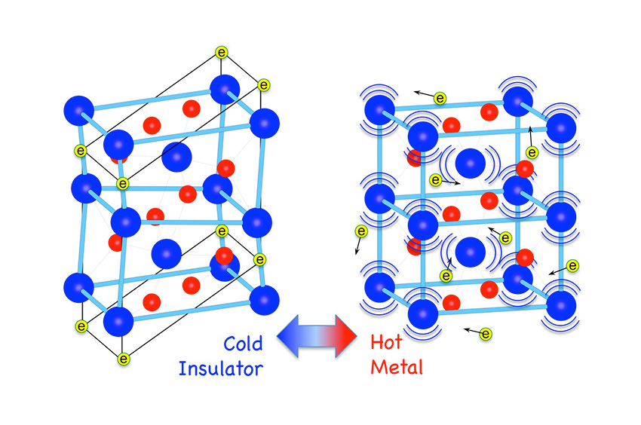
VO₂ as an Optical Phase Change Material
Can be a semiconductor or conductor
Semiconductor below 68$℃$
Conductor above 68$℃$
Phase change can be reversable
The introduction of a heat source causes a phase change
The removal of the heat will reverse the phase change
Behaviour of light depends on wavelength and temperature

Slide 28
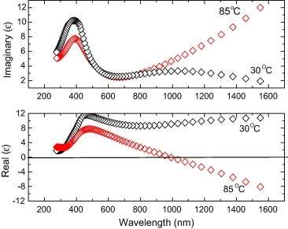
Permittivity of VO₂ ($ε= ε^{′}+i∙ε′′)$

Slide 29
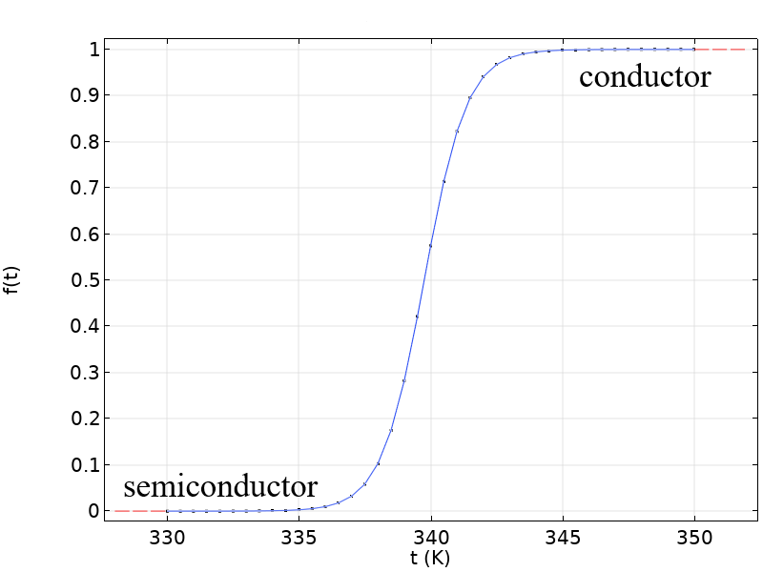
Fill Fraction of VO₂
$$f \left(T\right)=1 − \frac{1}{1+e^{(0.986T −335)/0.8}}$$

Slide 30
Permittivity of VO₂
Needed for all phases of VO₂
Semiconductor, conductor, and in between
Fill fraction equation needs to be used to know the phase
Maxwell-Garnet Theorem can be used to

Slide 31
Cross Sections of Nanoparticles
Absorption
Scattering
Relies on power loss density of particle and intensity of light
$C_{a}= \frac{\iiint{q dV}}{I}$
where to find the power loss density, it is given that:
$q= \frac{Re(J∙E^{∗})}{2}$
Overall, this becomes:
Relies on the Poynting Vector (E x H), direction of propagation of light
Relies on normal vector to the surface of VNP
$C_{s}= \frac{\iint{(n ∙S_{s}) dS}}{I}$
$S_{s}=E_{s}×H_{s}$
Overall, this becomes:

Slide 32
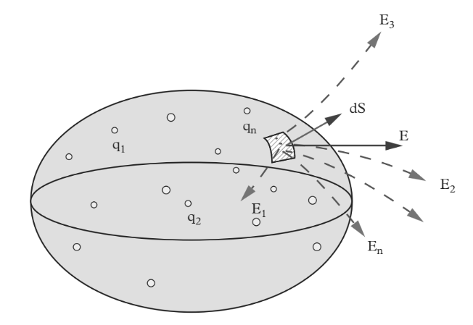
Scattering Cross Section of Nanoparticles

Slide 33
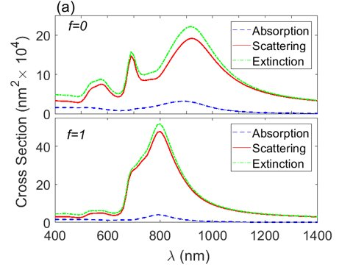
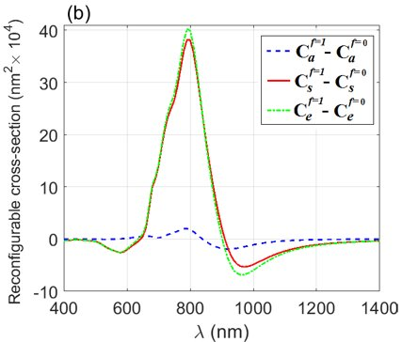
Solving for all Cross Sections of Light
Both Phases of VO₂
Reconfigurability Factor
Maximum reconfigurability of scattering occurs at 790 nm
Notes:
Peaks are for dipole, quadrapole, eight- poles…

Slide 34
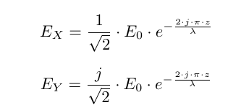
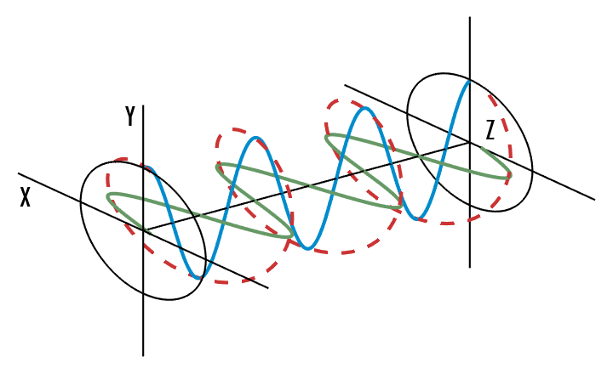
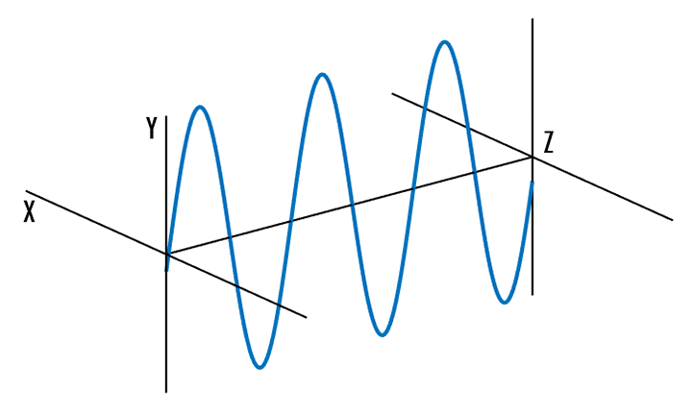
Electromagnetic Field Polarizations
Linear
Circular
Propagates along the x-axis
Relies on one equation
Depends on initial electric field and wavelength
Rotates around the z-axis
Electric field now has two components

Slide 35
Electric Field Enhancement (FE)
A structure, such as the VNP, may localize and enhance the initial electric field
Similar to an antenna
Uses electric field found at each location and initial electric field
$$FE= \frac{E}{E0}$$
Notes:
Tie back to introduction

Slide 36
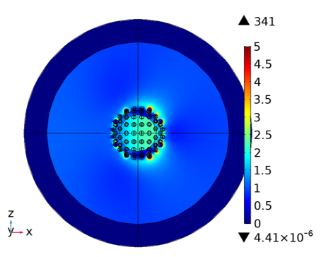
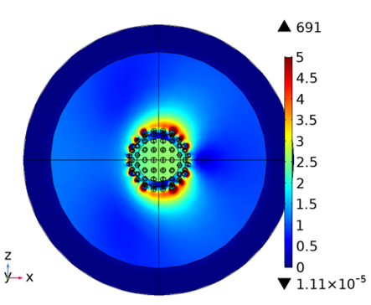
Electric Field Enhancements
Linear, f = 0, λ = 790 nm
Linear, f = 1, λ = 790 nm
Notes:
PML is used to kill the back scattering
Emphasize the legend
Make figures larger

Slide 37
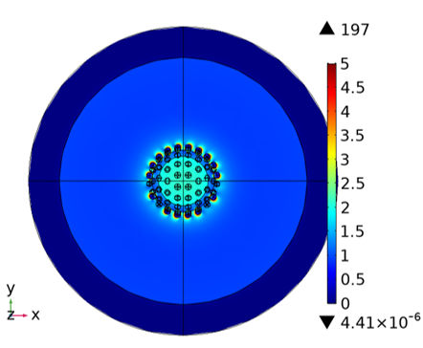
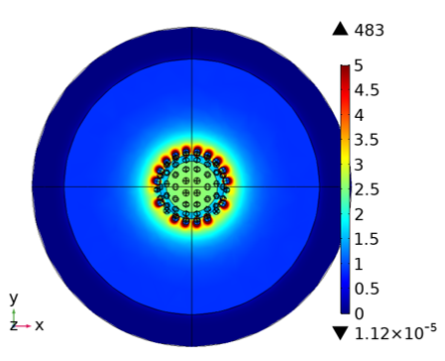
Electric Field Enhancements
Circular, f = 0, λ = 790 nm
Circular, f = 1, λ = 790 nm

Slide 38
Intensity of Laser
Previously given a constant value throughout
95 KW/m² for semiconductor
105 KW/m² for conductor
Desired outcome is to cause a phase change through changing the intensity of light at λ = 790 nm
Absorption, scattering, and extinction cross sections must be found again
Both polarizations are used

Slide 39
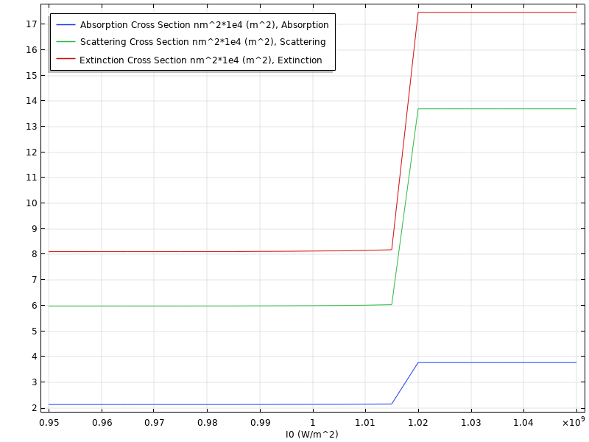
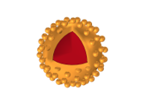
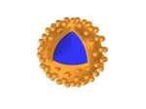
Cross Sections of Light, Linear, λ = 790 nm
VO₂ as a conductor
f = 1
VO₂ as a semiconductor
f = 0

Slide 40
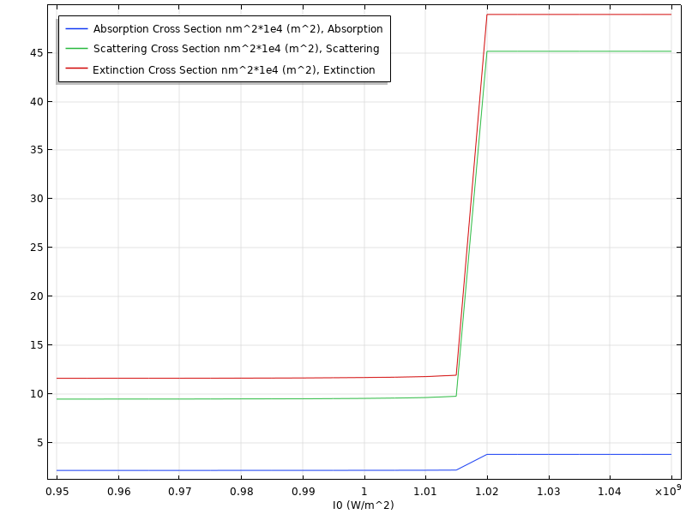
Cross Sections of Light, Circular, λ = 790 nm
VO₂ as a conductor
f = 1
VO₂ as a semiconductor
f = 0
Phase change begins at 101.5 KW/m² for both polarizations

Slide 41
Thermodynamics
Solved simultaneously with Maxwell's electric field equations
Stationary solution (t = 0 s)
The heat generation, e_{gen}, relies on the electric field
Heat of system will only be influenced by light source
Light intensity will determine if phase change occurs
Above 101.5 KW/m² for phase change
The heat transfer equation is:

Slide 42
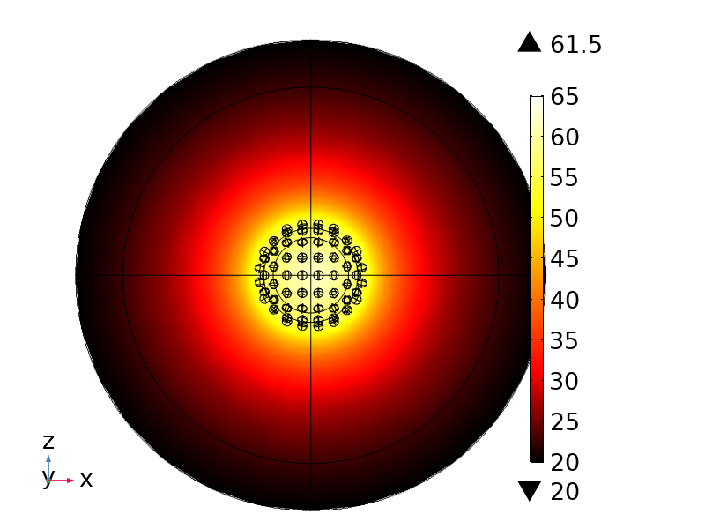
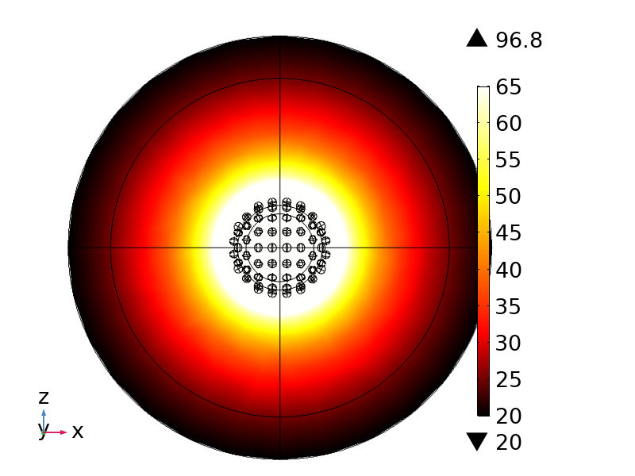
Thermodynamics
Linear, λ = 790 nm, I = 95 KW/m²
Linear, λ = 790 nm, I = 105 KW/m²

Slide 43
Thermodynamics
Circular, λ = 790 nm, I = 95 KW/m²
Circular, λ = 790 nm, I = 105 KW/m²

Slide 44
Applications for VNP

Slide 45
Applications for VNP
Nano Thermal Sensor
Cell Imaging
Scattering is 4.14 times larger when core is conductor
Above a specific temperature, more light would scatter, making the range temperature known
Particles inserted where imaging needs to take place
Shine a high light intensity laser
Senor will detect differences created by other cell types

Slide 46
Conclusion for VNP
The VO₂ core allows for tunability
Allows for uses in both semiconductor and conductor phases
Allows for heat activated response
Nanoseeds allow for increase in electric field enhancement hot spots
VNP has a strong ability to scatter light when core undergoes phase change
Many uses for VNP just by changing light source
Geometry will remain the same

